Slide 1
Fuel Consumption In Ghana
By Sonia D. Tachie-Menson

Slide 2
Introduction
This study explores Ghana’s fuel consumption trends and patterns and how they relate to inflation, GDP growth and environmental sustainability
The research is motivated by the need for data-driven insights to guide policy decisions in energy planning, fiscal management, and environmental regulation.

Slide 3
Objectives
Examine historical fuel consumption data to identify patterns.
Correlate fuel usage with macroeconomic indicators.
Visualize findings through dashboards.
Recommend strategies for sustainable fuel usage and economic planning.

Slide 4
Methodology
Correlation & Regression Analysis
Economic Impact Assessment
Data Visualization
Data Sources:
Fuel & Energy Data:
Bank of Ghana
Ghana Statistical Service
Ghana Energy Commission
Ghana Opendata Initiative.
Macroeconomic Indicators:
GDP
Inflation & CPI (Sources: BoG, GSS, World Bank, IMF).

Slide 5
Tools & Techniques
Excel: data cleaning, statistical analysis
Python: data exploration and visualization
Power BI: data visualization and dashboard

Slide 6
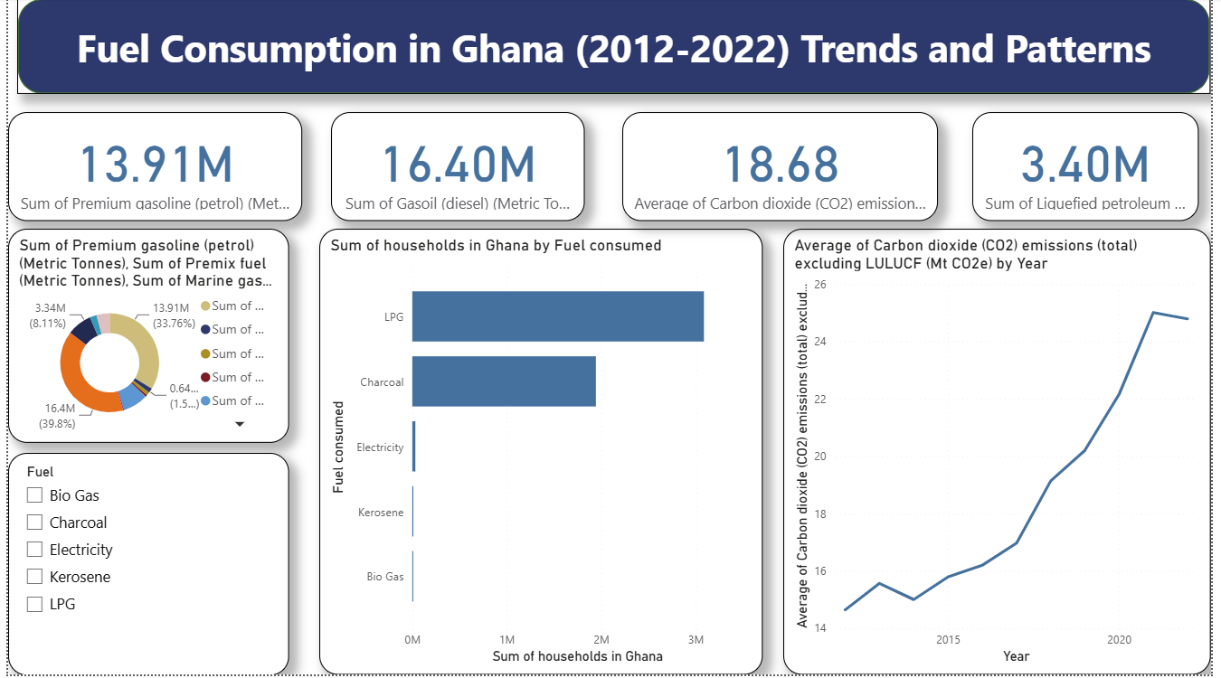
Page 1
Notes:
shape
No alt text provided
card
No alt text provided
card
No alt text provided
card
No alt text provided
donutChart
No alt text provided
lineChart
No alt text provided
clusteredBarChart
No alt text provided
card
No alt text provided

Slide 7
Insights
Fuel consumption and emissions are rising together signaling growing energy demand and environmental pressure
Diesel and petrol are the largest contributors, likely driven by transportation and industrial activities
Household energy mix shows a transition toward LPG, but traditional fuels like charcoal remain prevalent
LPG adoption in households adds to emissions despite being cleaner than charcoal

Slide 8
Recommended Policy Actions
Incentivize electric vehicles and hybrid cars
Expand LPG access while introducing biogas and solar alternatives for households
Enforce fuel efficiency standards for vehicles
Encourage public transport to reduce reliance on private cars
Implement carbon taxes or cap and trade systems for high emission sectors
Monitor and regulate industrial fuel usage
Invest in renewable energy especially for rural households
Strengthen fuel consumption and emission tracking systems
Educate households on the environmental impact of charcoal and kerosene

Slide 9
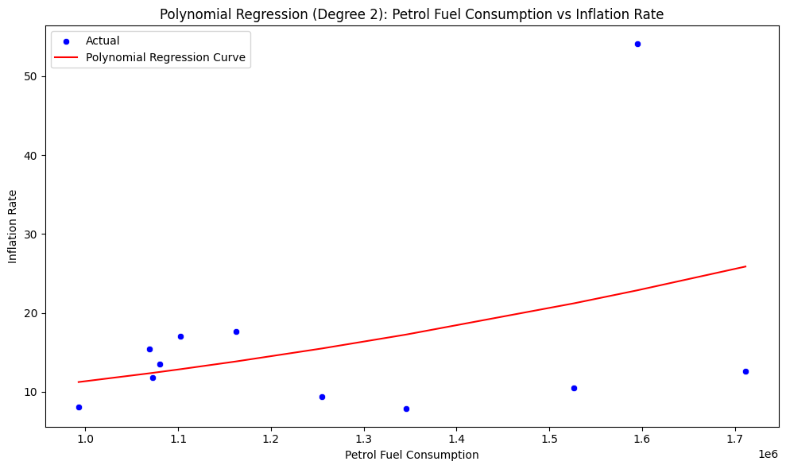
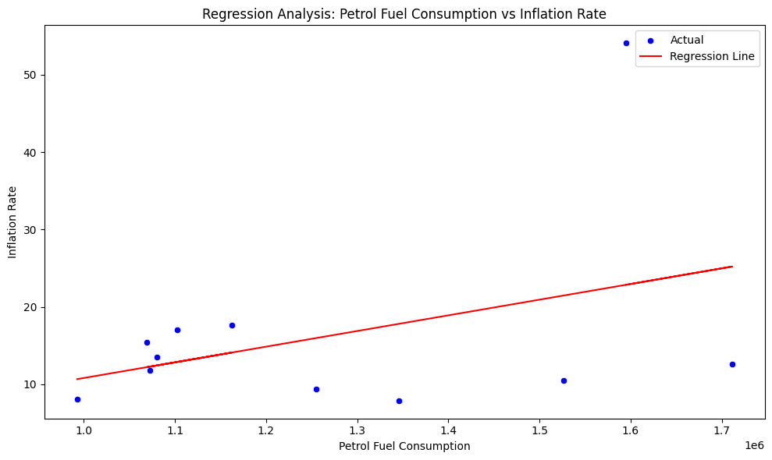
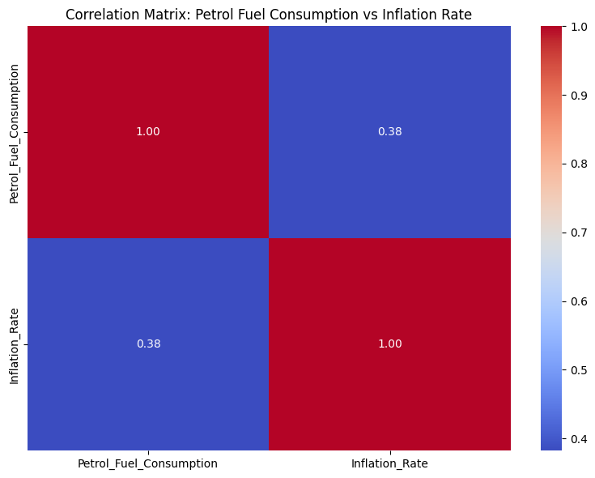
KEY PATTERNS
The polynomial regression suggests that inflation does not rise proportionally with fuel consumption, other macroeconomic factors influence the trend.
As petrol fuel consumption increases, inflation tends to rise
However, the polynomial curve is relatively flat, suggesting a weak and non-linear relationship
Correlation matrix indicates a moderate positive correlation but other factors also play a significant role

Slide 10
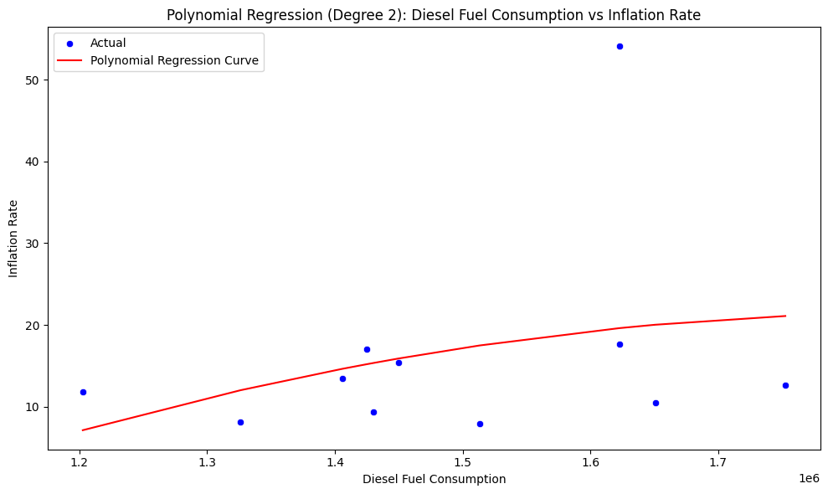
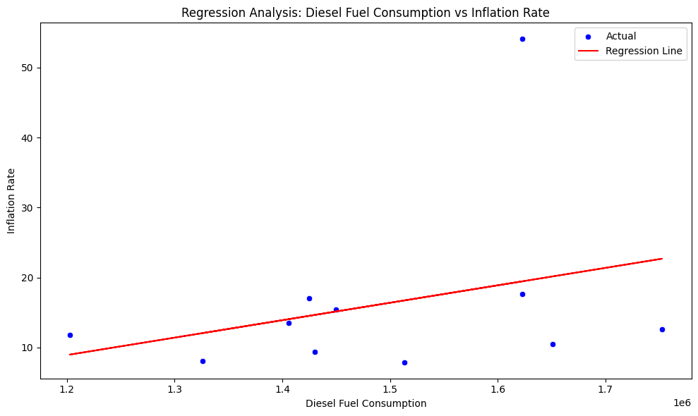
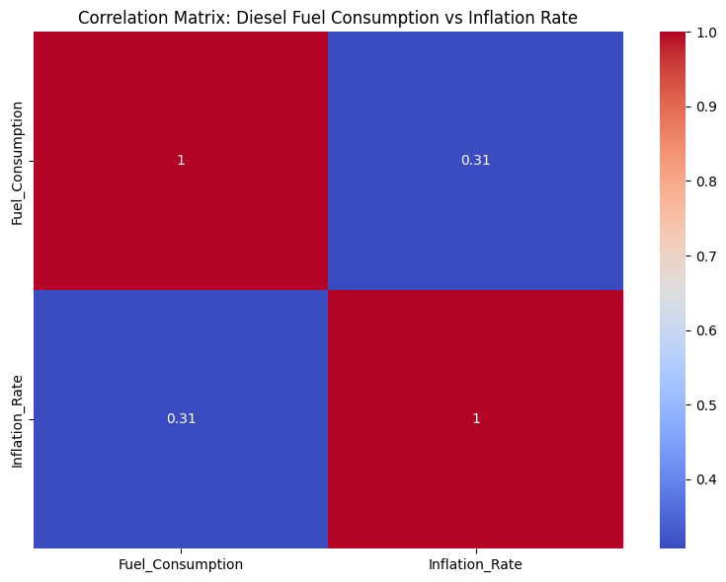
KEY PATTERNS
As diesel fuel consumption increases inflation tends to rise
Polynomial curve suggests a non-linear effect meaning the impact is modest
Correlation matrix shows a weak positive correlation indicating that diesel consumption has little direct influence on inflation compared to other factors
Outliers are not explained by diesel consumption alone, likely due to external shocks like currency depreciation or global oil price volatility

Slide 11
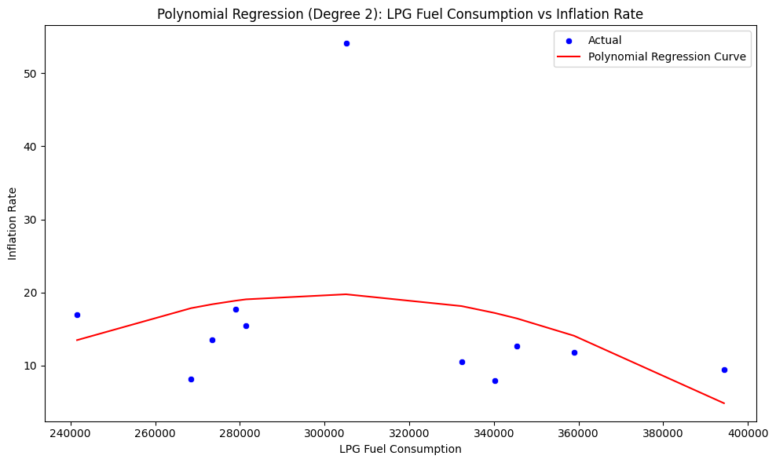
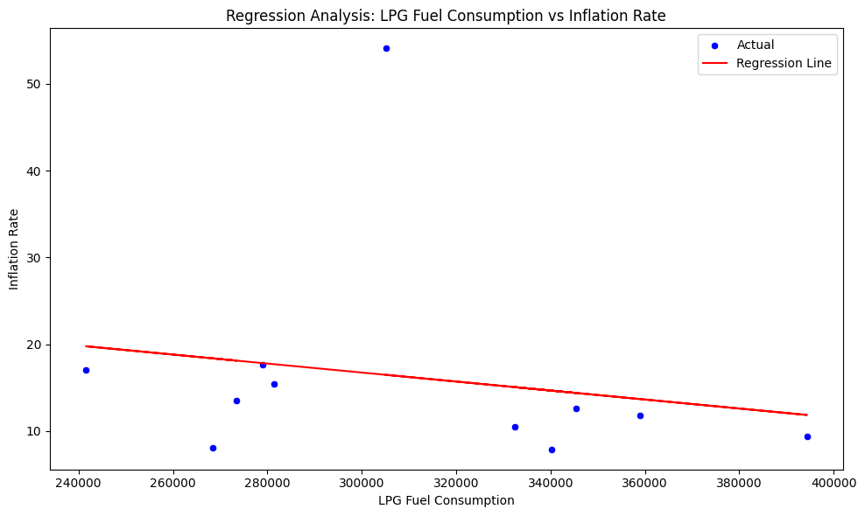
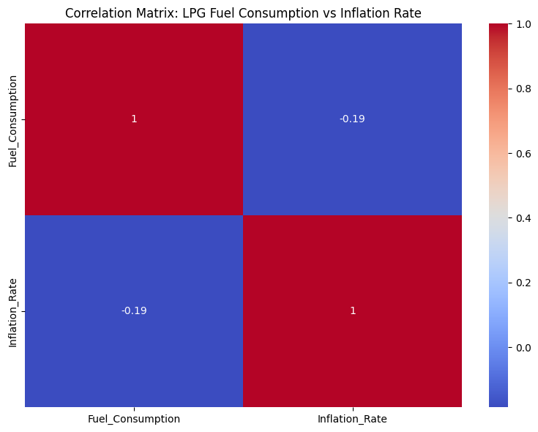
KEY PATTERNS
Unlike petrol and diesel, LPG consumption seems to have a stabilizing effect on inflation.
The polynomial regression curve shows a non-linear relationship
The linear regression line slopes downward, indicating an overall negative relationship between LPG consumption and inflation
Correlation matrix indicates a weak negative correlation which suggests that LPG consumption is associated slightly lower inflation

Slide 12
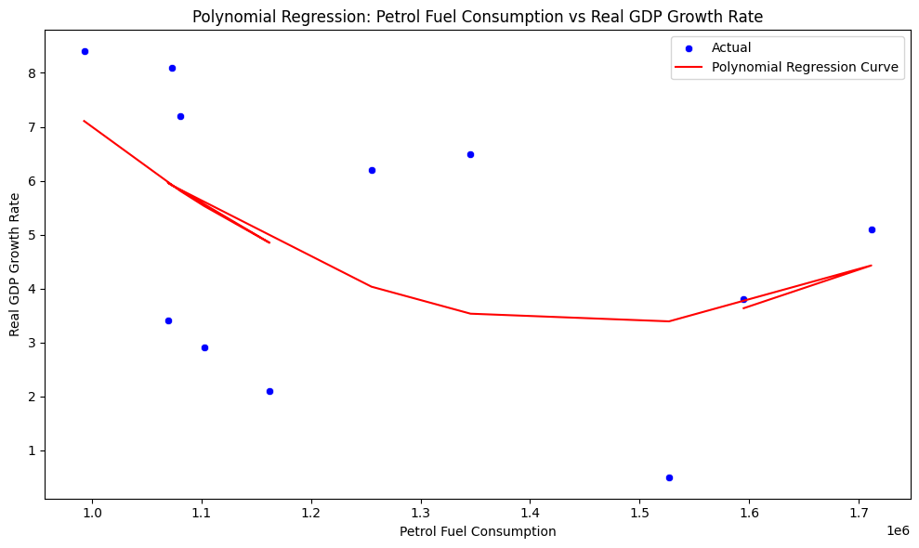
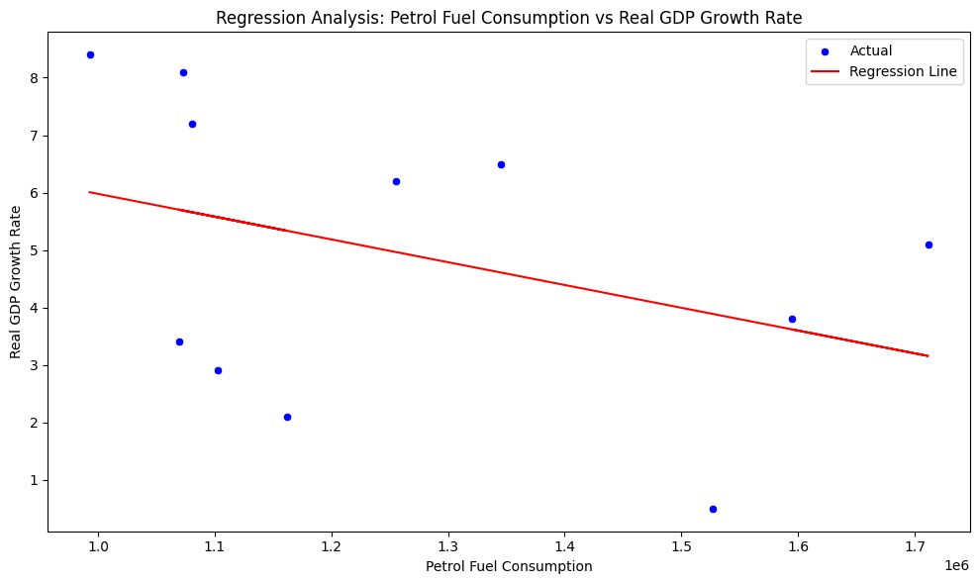
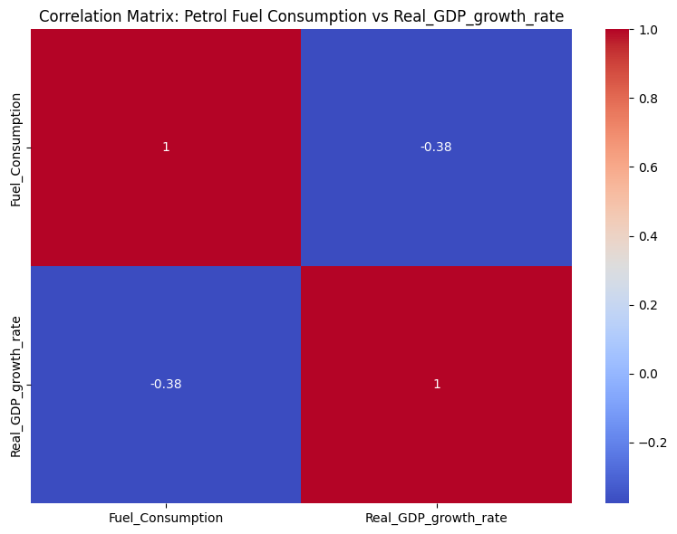
KEY PATTERNS
As petrol fuel consumption increases, real GDP growth tends to decline
The polynomial regression curve suggests that beyond a certain point, higher petrol consumption does not translate into economic growth.
Correlation coefficient shows a moderate negative correlation
Higher petrol consumption is generally associated with less economic activity

Slide 13
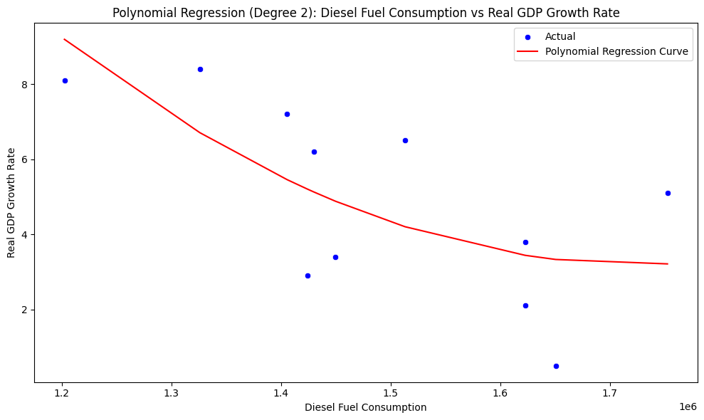
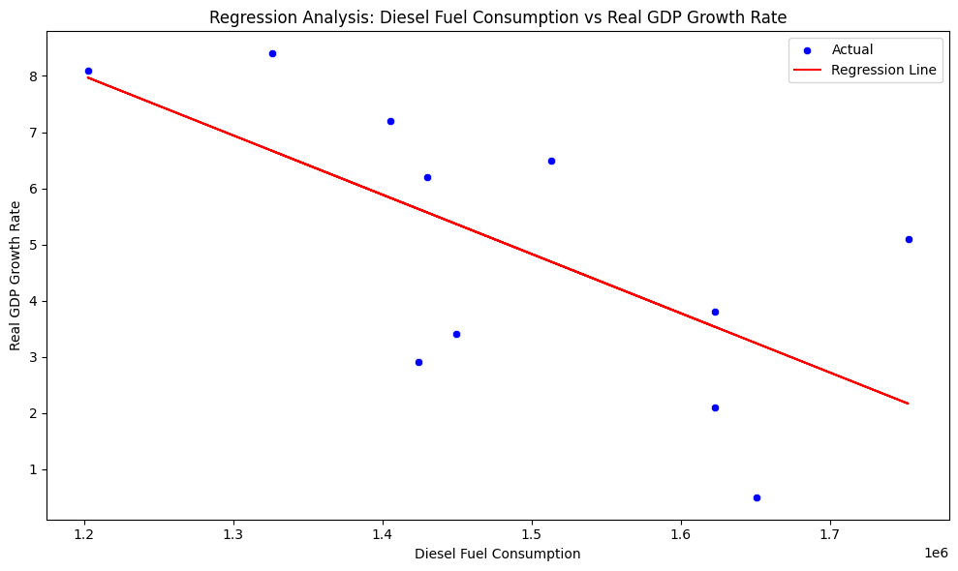
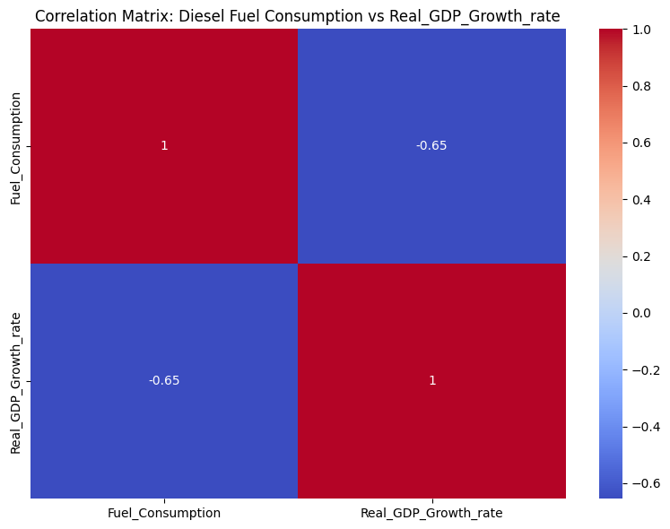
KEY PATTERNS
Both the linear and polynomial regression show a negative relationship: as diesel fuel consumption increases, real GDP growth decreases
Correlation matrix indicates a strong negative correlation
This means higher diesel consumption is strongly associated with lower GDP growth implying inefficiencies or economic stress linked to diesel use

Slide 14
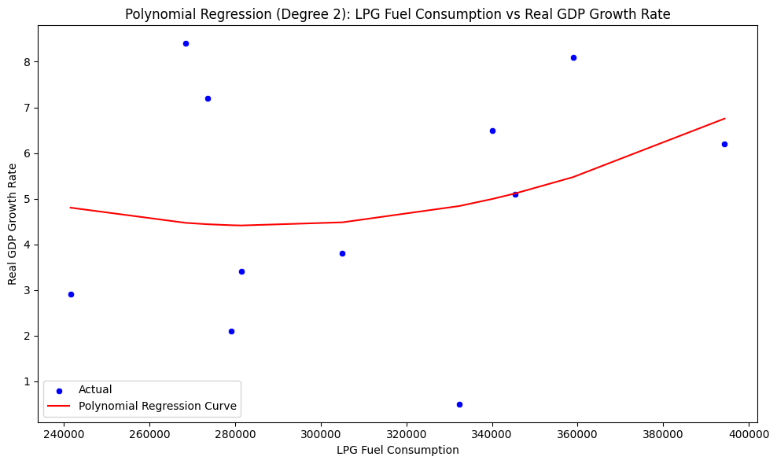
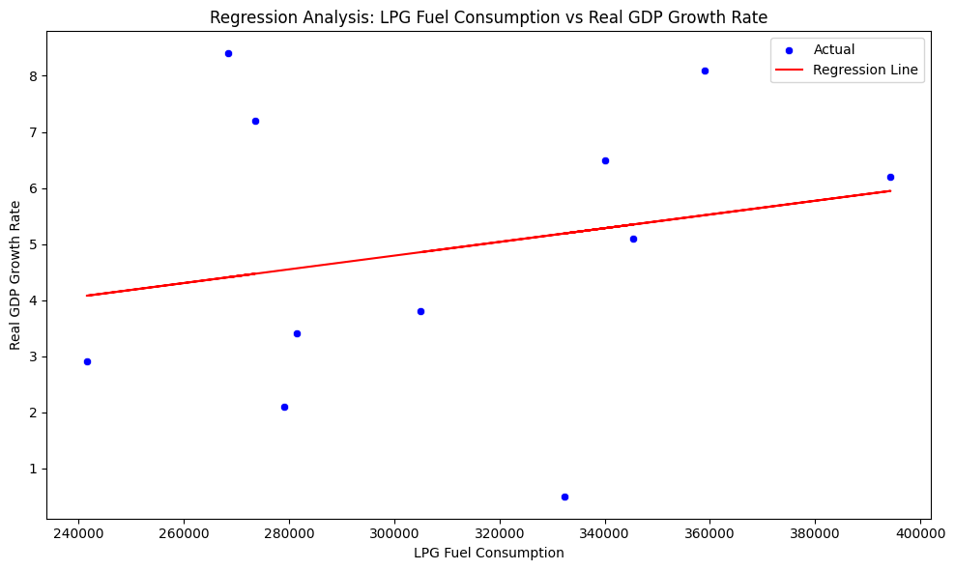

KEY PATTERNS
Linear regression indicates a positive relationship
Polynomial regression curve shows that greater LPG adoption correlates with improved economic performance
Correlation matrix indicates a weak positive correlation
This means LPG consumption has a modest but positive association with GDP growth
LPG supports household and industrial processes

Slide 15
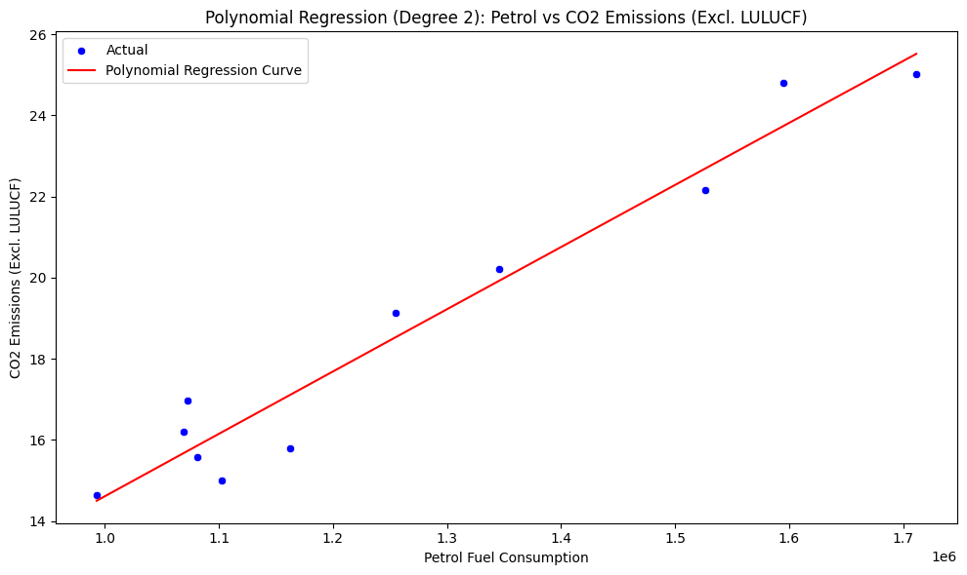
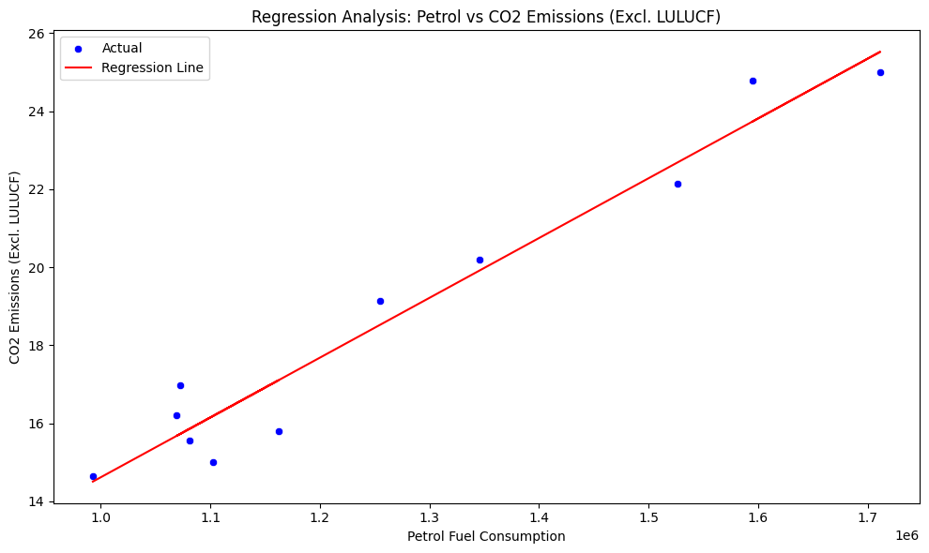
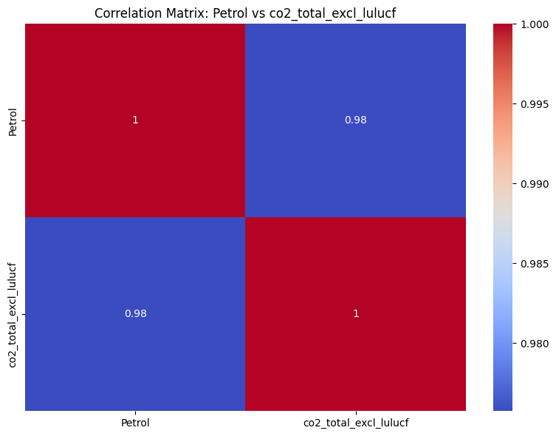
KEY PATTERNS
Both linear and polynomial regression show a strong positive relationship between petrol consumption and CO2 emissions
The trend is almost perfectly linear meaning higher petrol consumption directly drives higher CO2 emissions
Increase in petrol use will almost certainly lead to higher carbon emissions
Improving fuel efficiency will have an immediate and measurable impact on emissions

Slide 16
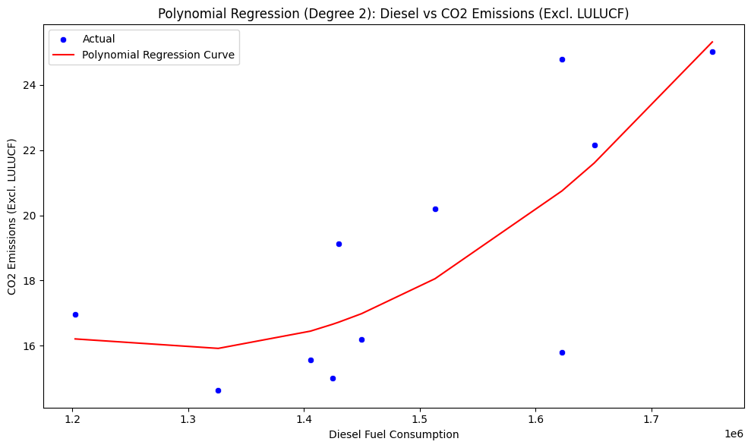
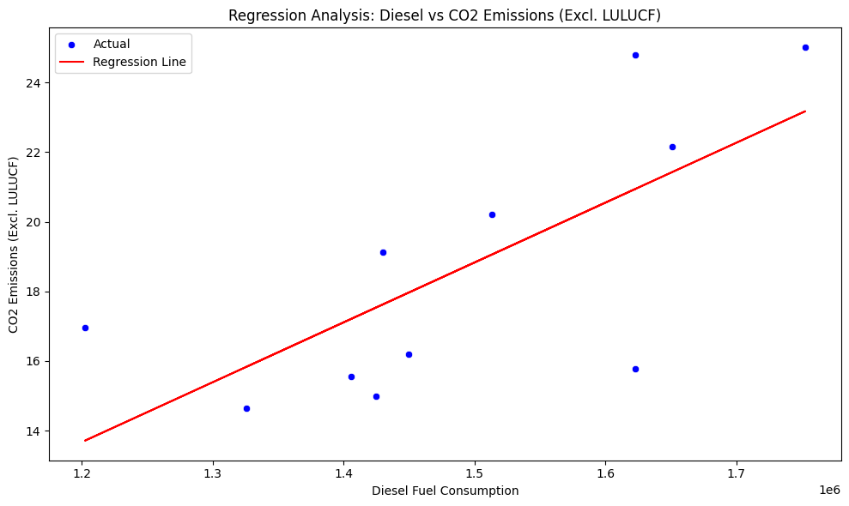

KEY PATTERNS
Both linear and polynomial regression show a positive relationship: as diesel fuel consumption increases CO2 emissions rise
Correlation matrix shows a strong positive correlation
This means diesel consumptions is a major contributor to Ghana’s CO2 emissions though slightly less petrol
Diesel is heavily used in transport and industry so its emissions footprint is significant and likely to grow with economic activity

Slide 17
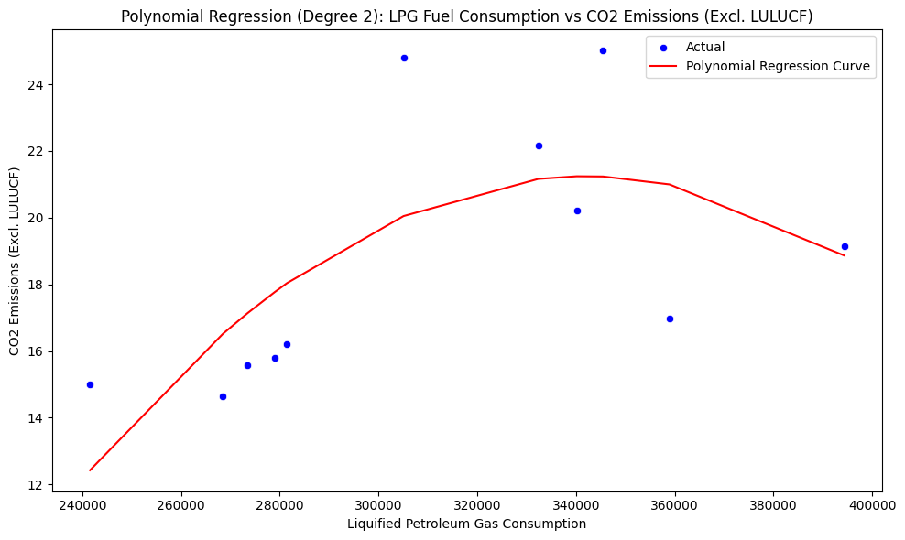
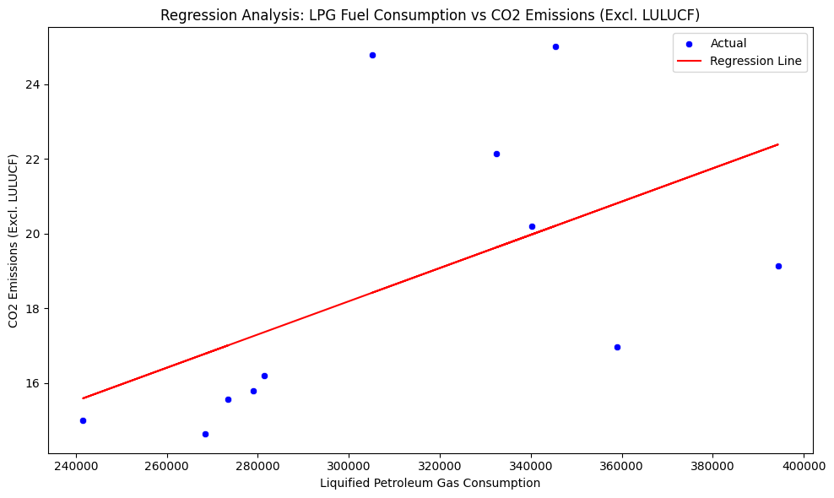

KEY PATTERNS
LPG emits CO2 but at a lower intensity compared to petrol and diesel
Correlation matrix shows a moderate positive correlation
While LPG is better than traditional biomass fuels it still adds to emissions
Policies must balance energy access with climate goals

Slide 18
Conclusion
Both petrol and diesel show a negative correlation with real GDP growth suggesting that higher consumption does not translate into proportional economic gains, instead it may reflect inefficiencies, rising import costs and inflationary pressures
These fuels show positive correlation with CO2 emissions indicating significant environmental costs
LPG consumption demonstrates a positive correlation with GDP growth and moderate link to emissions positioning it as a transitional fuel that supports economic activity while reducing reliance on more carbon-intensive fuels
Petrol and diesel consumptions show weak positive correlations with inflation while LPG has a slight negative correlation suggesting LPG adoption could help stabilize household energy costs

Slide 19
Recommendations
Diversify energy sources: Scale up LPG and renewable energy to reduce dependence on petrol and diesel
Improve efficiency: enforce fuel economy standards and invest in public transport and electric mobility
Environmental regulation: introduce carbon pricing and emission caps for high polluting sectors
Economic resilience: use oil revenues for infrastructure and clean energy investments to mitigate volatility
Data-driven governance: continuously monitor fuel consumption, GDP and emissions to guide adaptive policies

Slide 20


